Slide 1
Analysis of Twitter reviews for new video games
Khaled AI Masaid
Larbi Farihi
Peirou (Emma) Zhang
Leying (Dorothy) Zou

Slide 2
Why does mining video game reviews matter?
Reviews contain insights on aspects users either like or dislike about new video games
Analysis of reviews can help determine whether a video game is recommended or not
Goal of this project is to apply Text Analytics methods on reviews to determine consumers’ satisfaction or dissatisfaction
Data source: extract reviews from Twitter for the following games:
Cyberpunk 2077
NBA 2K21
FIFA 21
Assassin's Creed Valhalla
Call of Duty: Black Ops Cold War
Notes:
Consumers posting product reviews play an essential role in product development
We can apply text analytics methods on the reviews to provide businesses an overview of consumers’ satisfaction or dissatisfaction
By analyzing reviews, additional information can be extracted to gain a better understanding of the voice of users

Slide 3
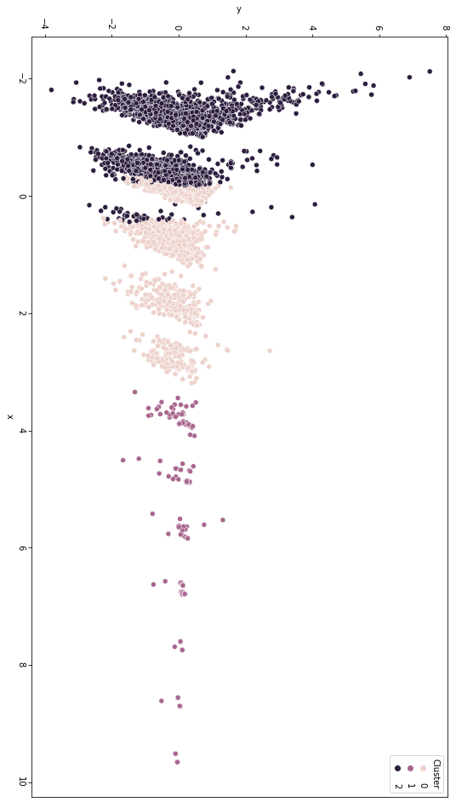
K-means clustering
Use K-means clustering to create clusters based on similarity of reviews
Unsupervised learning algorithm can provide great insight from user reviews
Make it easier to identify user perception of a video game
Notes:
We used K-means clustering to create clusters based on similarity of reviews
We first started by creating Term frequency - Inverse Document Frequency TF-IDF matrix
Then we fit this matrix into the K-means model
K-Means clustering is an unsupervised learning algorithm
The data is fed into the learning algorithm which determines how to label the tweets
The model groups Tweets based on their similarities
In the figure on the slides, we plotted the results of the K-means model for Assassin's Creed Valhalla
The ideal number of clusters is 3
Each cluster can represent review category such as positive, negative or neutral
The results of K-means model can create useful visuals that gives an overview of customers’ reaction to a product,
it makes it easier to identify users’ perception of a video game.

Slide 4
Sentiment Analysis
Based on VADER unsupervised method:
Games | Positive | Neutral | Negative | Overall Score
Call of Duty: Black Ops Cold War | 46.81% | 35.71% | 17.48% | 29.33
FIFA 21 | 43.07% | 42.79% | 14.14% | 28.93
CyberPunk 2077 | 43.14% | 35.75% | 21.11% | 22.03
NBA 2k21 | 35.31% | 51.08% | 13.61% | 21.7
Assassin's Creed Valhalla | 15.72% | 10.98% | 73.3% | -57.58

Slide 5
Topic Modeling Based on LDA assumptions
Bag of words → Run LDA model → Probability visualization
NBA 2K21
Ps5share
Xboxshare
2kcommunity
FIFA 21
League
Futurestar
Ps5share
Cyberpunk 2077
Account
Rt-smallstreams, Streamer wall, PromotingAMGamers
sale
duty
Assassin's Creed Valhalla
Phollarkemie1
Call of Duty: Black Ops Cold War
Account
Rt-smallstreams, Streamer wall, PromotingAMGamers
League
season
gameplay
Notes:
xcvxcv

Slide 6
Insights/Recommendations:
Recommendations:
Enhance our rating system by attributing weights to twitter accounts based on their reliability
Extend the depth and breadth of our data by targetting additional social media platforms and forums
Build an aggregated Dashboard to analyze game reviews in a user-friendly fashion
Insights:
Text analytics on user reviews can make it easier to identify any existing issues with a video game
Help users with their decision making by having a better awareness of the general customer satisfaction level
Generate the integrated evaluation of games by sentiment analysis helped marketing teams of the game companies to adjust their strategies
Measure the public feedback of games and the commonly used words that strongly correlated to the games from big data
Notes:
Text analytics on user reviews can make it easier to identify any existing issues with a video game
Therefore the next generation of the game will be an improvement and satisfy user requirements
Users have a better awareness of the

Slide 7
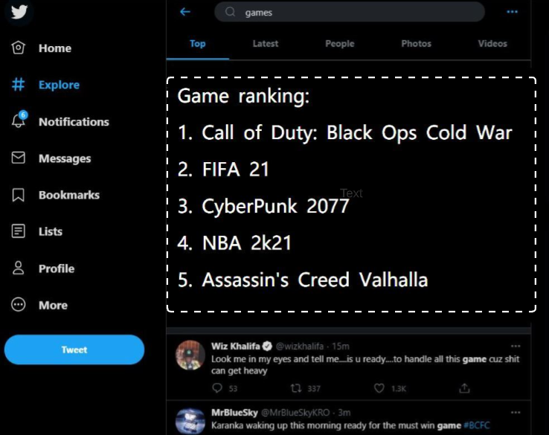
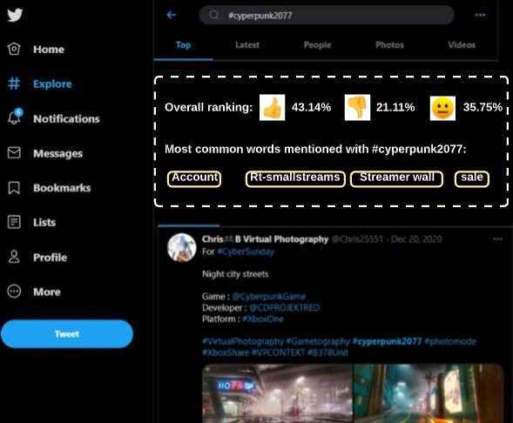
Recommender System:
When users search "game" :
When users search game hashtag:
Notes:
1. provide the game ranking when twitter users seach "game"
2. provide the evluation of the game when users search the hashtag for specific game name

